Slide 1

AEROSPACE SECTOR IN MEXICO
June 2021

Slide 2
Aerospace Sector
The total Foreign Direct Investment (FDI) received in the aerospace sector from 1999 to 2020 amounts to $ 3,470.6 million USD.
Country of Origin | FDI (million dollars) | Participation share | Number of companies
USA | $2,232.6 | 63.9% | 63
Canada | $858.9 | 24.6% | 5
France | $258.9 | 7.4% | 13
Spain | $120.2 | 3.4% | 12
TOTAL | $3,470.6 | 99.3% | 93
13%
7%
28%
11%
20%
21%
Fuente: Secretaría de Economía

Slide 3



Aerospace Sector
FDI in the aerospace sector, 2007-2020 (million dollars)
Main companies from the top 3 countries with the highest FDI in the sector
Canada
USA
11%
France
Fuente: Secretaría de Economía

Slide 4
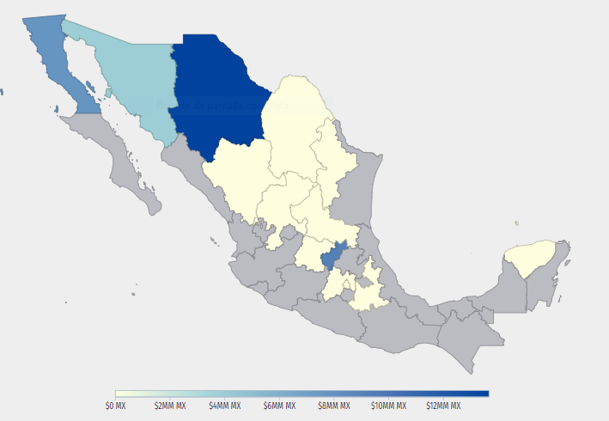
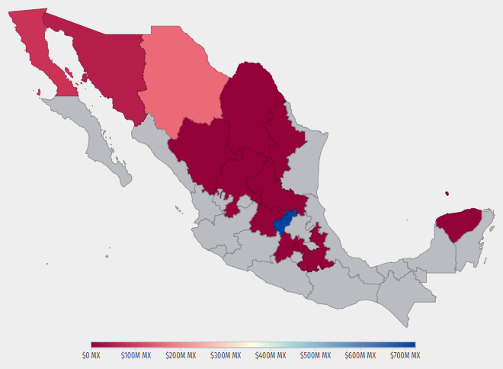
Aerospace Sector
In the fourth quarter of 2020, a GDP of $ 4.5 billion USD was recorded, showing an increase of 1.92% compared to the previous quarter.
The states with the highest added value were Querétaro, Chihuahua and Baja California.
In Aerospace Equipment Manufacturing, the states with the highest production were Chihuahua, Querétaro, and Baja California.. In addition, there was new investment, mainly in Chihuahua, Querétaro, and Baja California.
TOTAL GROSS PRODUCTION DISTRIBUTION BY STATE (2019)
TOTAL INVESTMENT DISTRIBUTION BY STATE (2019)
Fuente: Secretaría de Economía / DataMexico

Slide 5
Aerospace Sector
Exports
aerospace industry (million dollars), 2004–2023
Fuente: FEMIA

Slide 6
Aerospace Sector
The aerospace industry has had an average annual growth of 14% since 2004.
In Mexico there are 368 industrial facilities in this sector.
The aerospace sector has generated more than 60,000 jobs and has presence in 19 out of the 32 states.
Currently, Mexico is ranked 12th in this sector..
The value of the world production in the aerospace sector surpasses $582 billion USD, North America is the region with larger share in worldwide production (51.1%).
Mexico is the #1 country in Latin America in aeronautic projects attraction. The main characteristics that makes the country attractive to investment are its geographic proximity to the US, trade agreements that grant access to big markets, experience in other high-tech sectors such as automotive and electric and skilled labor force.
Fuente: FEMIA

Slide 7
Components made in Mexico
Baja California:
-Precision machining, power and electrical systems interiors, surface and heat processes.
-Fuselage systems and power plants.
Sonora:
-High precision mechanical components, harnesses and wires, casting and machining processes.
-Blades and components for turbines and wind motors.
Chihuahua:
-Aeronautical electrical wiring.
-Ducts, gears and motor assembly axis, manufacture of blades, impellers, nozzles, discs, inductors, seals, nozzle segments.
-Helicopter cabins and fuselages, electrical harnesses.
Nuevo León:
- Maintenance, repair and overhaul for civil aviation; Investigation and development.
Querétaro:
-Machining of complex components, aerostructures, maintenance, repair and overhaul of engines and landing systems; composite materials.
-Assembly of fuselage, wings, horizontal and vertical stabilizers.
-Manufacture and installation of electrical harnesses.
-Parts of landing gears.
Fuente: ProMéxico. Plan Nacional de Vuelo. Industria Aeroespacial Mexicana. Mapa de Ruta 2014.

Slide 8
Aerospace Sector
The increase in the use of artificial intelligence, machine learning and automatization of robotic processes will boost process productivity in the value chain.
On the other hand, the Mexican Space Agency and UNAM signed an agreement to promote and develop space and satellite projects. This will give support to agriculture, natural disasters, climate change, cartography, oil and mining exploration and telemedicine.

